Slide 1
Presenter: Qiao, Wensong
GR 5243 Applied Data Science
Project 4 OCR (Optical Character Recognition)
Group 9 Team Members:
Karsok,Max
Sun,Shengjie
Zheng,Fei
Zhong,Ming

Slide 2


Outline
s
V
Baseline Model
Advanced Model
Flow chart
Import Data
Preprocess
Detection
Correction
Evaluation

Slide 3

Baseline Model
Error detection
Check whether word exists in ground truth. If any words are not in ground truth, the word is detected as error.
Error correction
Just simply remove the detected-errors
3 | Presentation Title Presentation Title

Slide 4
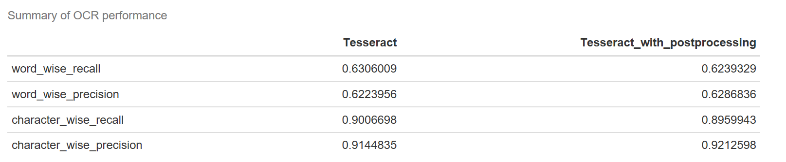
Baseline Model
Result
4 | Presentation Title Presentation Title

Slide 5

Advanced Model
Error detection
Method: Use of Dictionary
Idea: The error is detected when a word is not in the dictionary
Concept:
No error occur
Not Sure
In the dictionary
Word
Error occur
Might be transferred into another word in the dictionary
Must be Wrong
Not In the dictionary
5 | Presentation Title Presentation Title

Slide 6
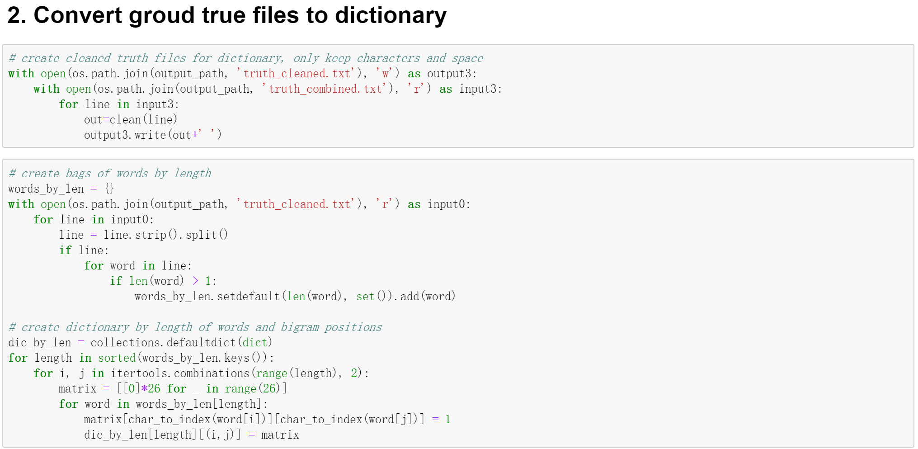
Advanced Model
Step 1
1
6 | Presentation Title Presentation Title

Slide 7
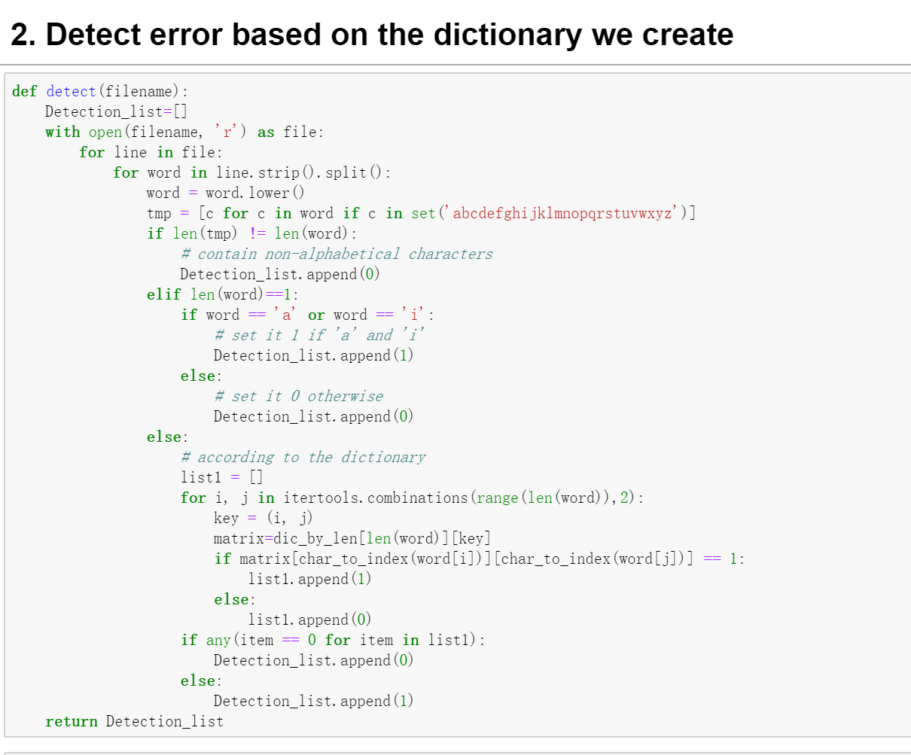
Advanced Model
Step 2
Rules: (0-error;1-good)
- If the word contains non-alphabetical characters, set it 0.
- If the word contains only one character, set it 1 if 'a' and 'i' and 0 otherwise.
- Then set 1 or 0 in other cases according to the dictionary we create.
7 | Presentation Title Presentation Title

Slide 8
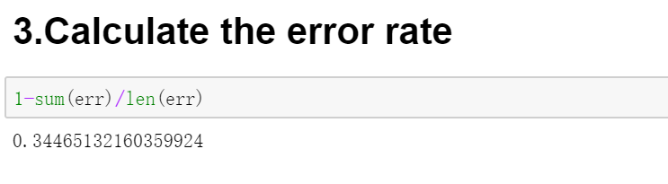
Advanced Model
Result:
8 | Presentation Title Presentation Title

Slide 9

Advanced Model
Error correction
Method: Statistical Learning Model
Idea: Build a regression model with six feature scores to predict what kinds of candidate we should choose to correct error.
Flow:
1. Divided all detected error in 75% and 25% as training set and test set
2. Do AdaBoost regression with weighted loss function
3. Predict label score for candidates in the test set
4.The highest label score candidate will be used to correct error
9 | Presentation Title Presentation Title

Slide 10
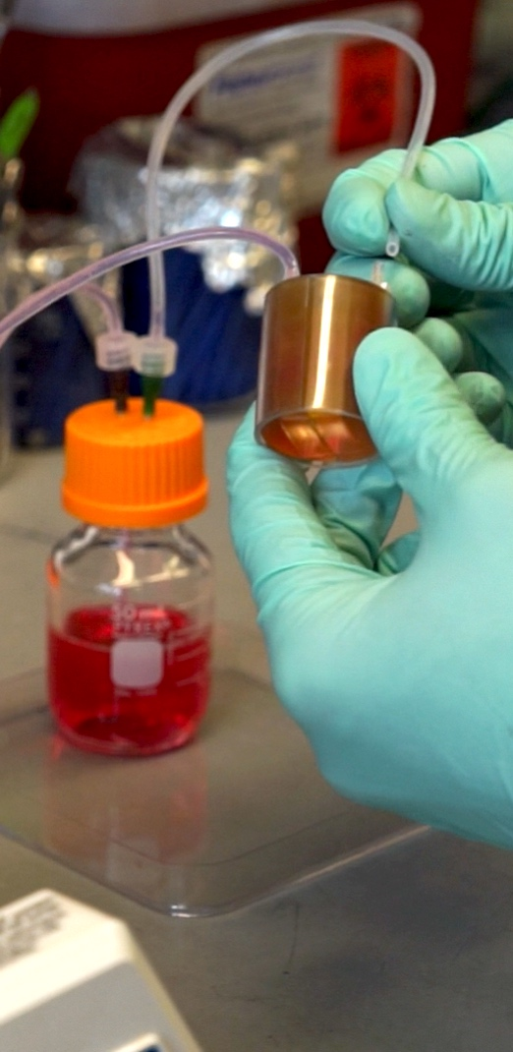
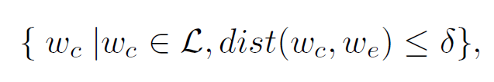
Advanced Model
1.Candidate Search：
Question: How can we know what kind of candidates(word) we should use for correction
Answer: Damerau-Levenshtein distance
e means error, c means candidate. δ is a distance threshold.
We use ground truth as dictionary to choose candidates
10 | Presentation Title Presentation Title

Slide 11
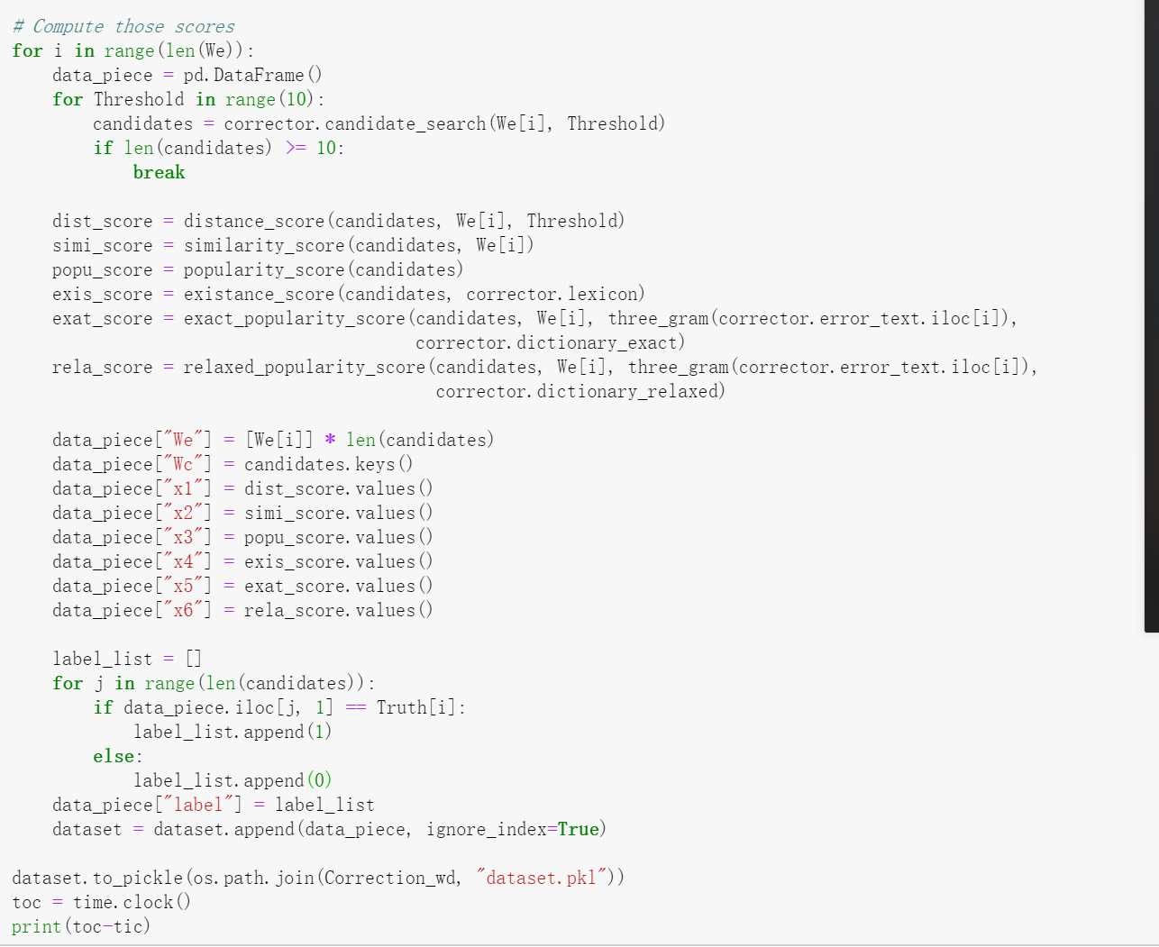
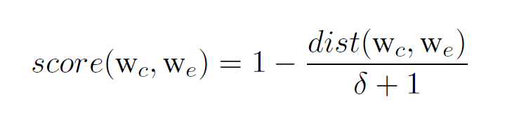
Advanced Model
2.Feature Score：
Idea: the measurement of similarity of different strings.
Types:
— Levenshtein edit distance score
— String similarity score
— Language popularity score
— Lexicon existence
— Exact-context popularity
— Relaxed-context popularity
Example: Levenshtein edit distance score
11 | Presentation Title Presentation Title

Slide 12
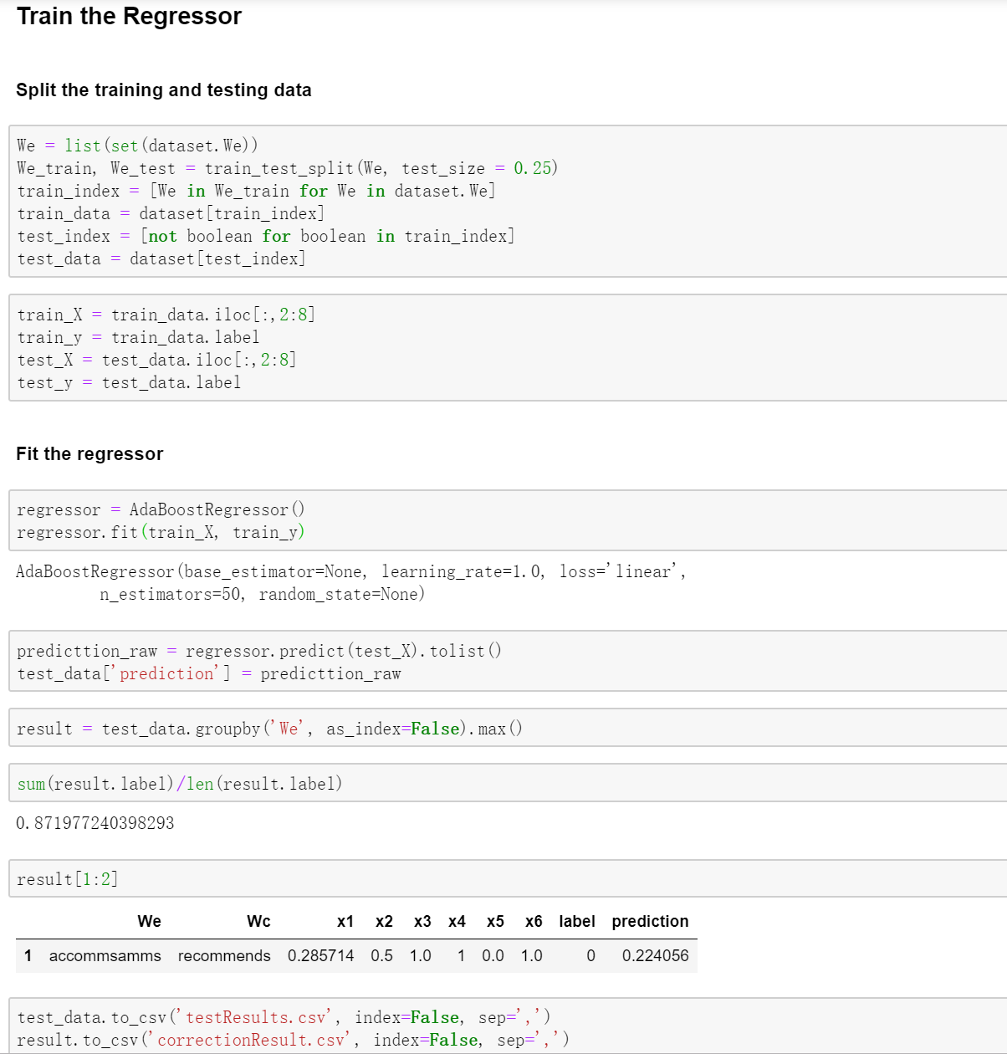
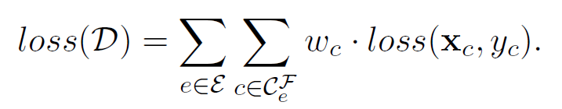
Advanced Model
3. Regression model ：
Model: AdaBoost
Loss Function: weighted loss function (deal with unbalanced label problem)
12 | Presentation Title Presentation Title

Slide 13
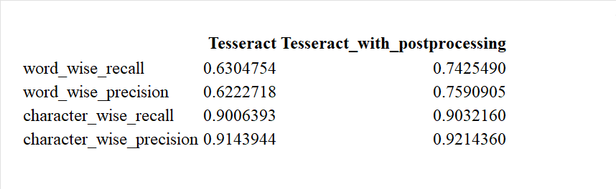
Advanced Model
Result:
13 | Presentation Title Presentation Title

Slide 14

Thank You!
TRANSCENDING DISCIPLINES, TRANSFORMING LIVES

